Slide 1
{Git}and
{GitHub}
A Simple To Understand Guide

Slide 2
—Albert Einstein
“Everything Should Be Made As Simple As Possible, But Not Simpler”

Slide 3
In This Guide
01
02
03
Learning Git
Learning GitHub
Git and Github

Slide 4

INTRODUCTION
Git is a version control system that allows multiple developers to work on a project simultaneously. It also tracks changes in project files during development.
Github is a web based solution to host git repositories with additional tools on top of git.

Slide 5
01
Learning Git

Slide 6
ABOUT GIT
Git is all about repositories (repo for short), you create a repo, you manage your repo and you do every git related task in your repo.
A repo is basically the location of your project, it is the folder that git tracks for changes and applies your commands on.

Slide 7




DEFINITION OF CONCEPTS
Commit
Branch
Merge
Remote
A Commit is a snapshot of the repo at a certain time, it is like saving all changes done on the repo
A branch is a line of development, it’s like creating a copy of your repo and working on that instead.
A merge is the command used to “merge” two different branches together, it basically merges the changes done in each branch.
A remote is basically a version of your repo hosted online on something like github, highlighting the difference between git and github.

Slide 8
CREATING OUR OWN REPO
To show you how simple it is to use git’s features

Slide 9
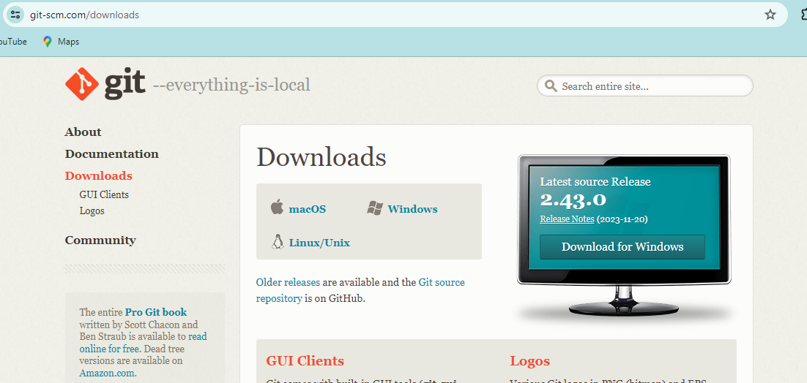
Downloading Git
In The git website, navigate to the downloads page and download git for your specific OS.
(we will be using windows)

Slide 10
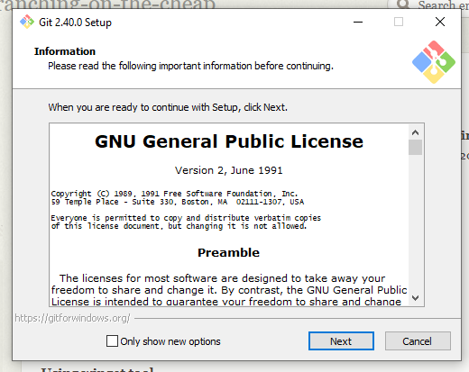
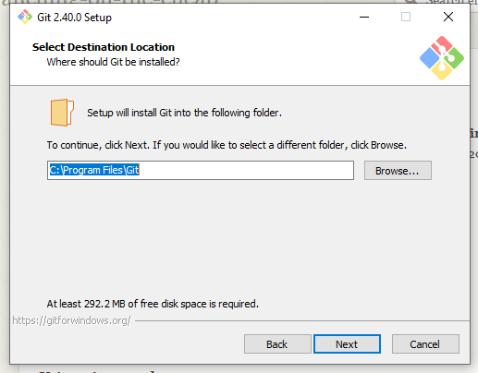
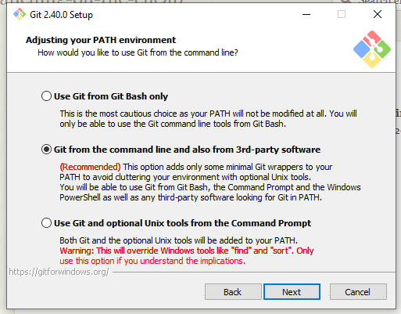
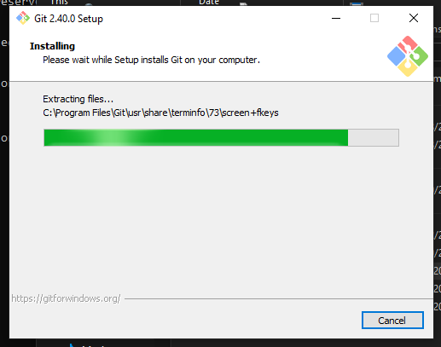
Downloading Git
After The Download, start the installer choose a location for git and just keep clicking next till the installation begins. (it is advised to not tamper with the recommended options).

Slide 11

Verifying Git Installation
To Verify Download, open new command prompt window and write git –version
It should give you the version of git you installed. (repeat previous steps if this fail and make sure to not tamper with recommended options in the installer)

Slide 12
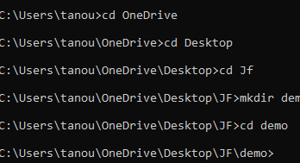
Initializing Git Repo
Navigate to your projects folder, here we create our folder called demo using windows mkdir command.
Use git init to initialize a new repo in your new folder. Git will create a hidden file called .git inside this folder, you do not need to touch this file but it’s good to understand that it contains all the necessary data for git to manage your repo properly.
.

Slide 13
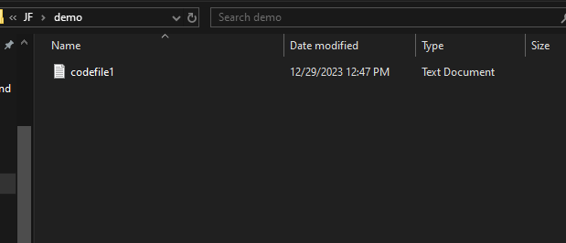
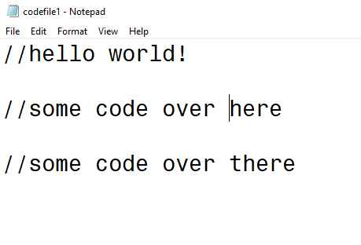
Making our first commit
We will create a text file, you can use any editor like sublime text or vscode… but for simplicity we will be using notepad. (git doesn’t really care what we use)
We wrote some text inside the file, now let’s got back to the command prompt.

Slide 14
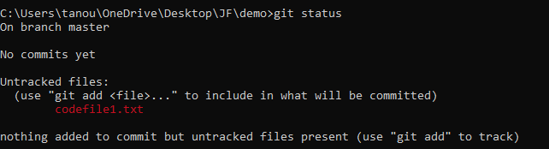
Making our first commit
Using git status command, we can see the files git is currently tracking and checking for changes.
Codefile1.txt is currently highlighted in red meaning it is untracked. Meaning, git will not check if this file have changed we can go change it right now and git will not notice.

Slide 15
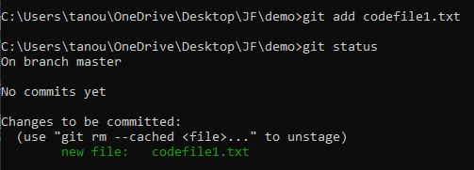
Making our first commit
Using git add command, we can tell git to start tracking the files we list, these files are also called staged files.
Now after using git add codefile1.txt, our file is now staged and is being tracked by git any change to it will be noticed, we use git status to check and you can clearly see how it’s highlighted in green.

Slide 16
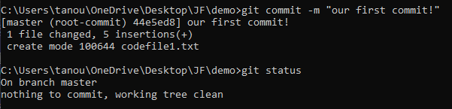
Making our first commit
Using git commit –m “message”, we can commit all our changes. This is basically like pressing the save button telling git to finalize all changes and take a snapshot of all the files right now.
As you can see git commit –m “our first commit!” is the command we are using, the message is just something for us to help us remember what this commit was about.
This time when we use git status, it tells us that this branch is clean and has all his files untouched and unchanged yet.
Congrats that was your first git commit in your first repository!

Slide 17
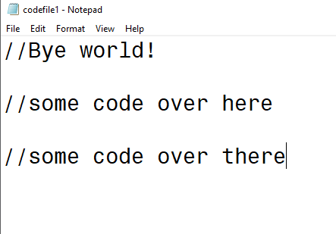
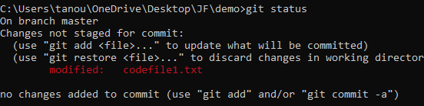
Managing Our Repo
We made some changes to our file let’s see what happens now
Since codefile1.txt is already staged this change has been detected and now it is highlighted in red again.
We use git add again but in this context git add doesn’t stage our file because it is already staged, here git add only updates the file changes. (using a dot rather than the filename just means add all files in the folder)

Slide 18
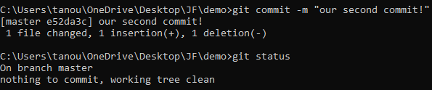

Managing Our Repo
Using git log –oneline, we can view our commits, which branch our Head is pointing to and where our branches are, also each commit gets it’s own hashcode to identify it.
Again, we use git commit –m “message” to commit our changes
Here, we can see that our Head is pointing at our master branch in our newest commit (the second commit) with a hashcode e52da3c.
The head is like a reference that git uses to know which branch it’s working on right now. It pointing to the master indicates that the current working branch is master.

Slide 19
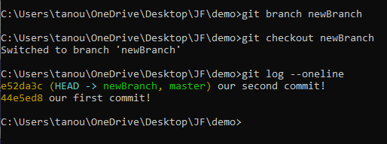
Branching
A new developer wants to work on our code but doesn’t want to add any commits that might mess up our code
Solution:
He/She must create a new branch, do whatever with that and then merge to the master branch when they are ready.
Using git branch <branchName>, we can create a new branch.
Using git checkout <branchname>, we can tell the head to point to our newly created branch.

Slide 20
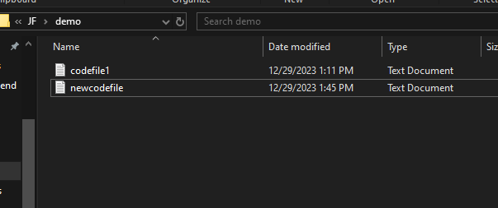
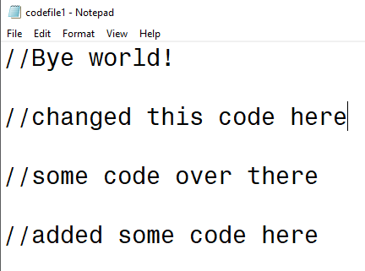
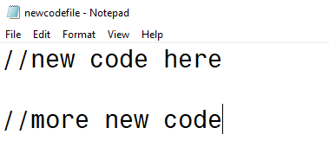
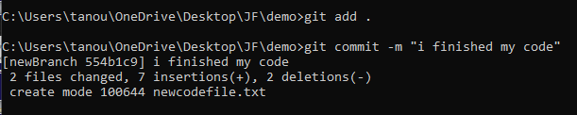
The new developer’s changes

Slide 21
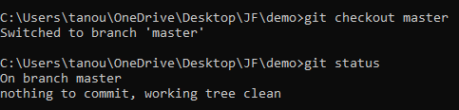
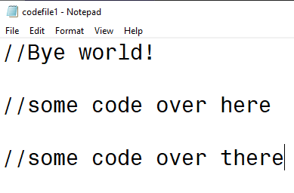
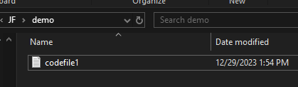
Branching
Let’s go back to our master branch and see if it worked. It tells us that our current branch is clean and everything is ok.
If we go back to our folder, we find the new file our new developer created does not exist, and the changes he made to the codefile1 are not present.

Slide 22
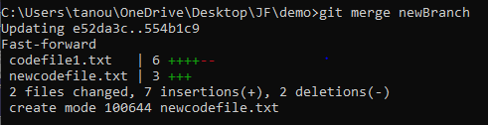
Branching
Not to worry! This is the cool thing about git branches, each branch is like it’s separate folder, before you merge the branches, the newly created files and changes simply don’t exist in other branches.
Using git merge <branchname> merges the the selected branch’s changes with the current branch’s changes. (no new branch will be created or destroyed but the command will just add all the changes done in the selected branch to the current branch.
While in master branch, we use git merge newBranch and all the changes done by the new developer in his branch are now added to the master branch.

Slide 23
BASIC REPO MANAGING
Step 1
Step 2
Step 3
Step 4
Step 5
Step 6
git branch <newbranch>
(create a new branch)
work on your project
git status
(see all the staged files and unupdated files)
git add .
(stage all files in project or update them)
git commit –m “message” (commit changes to this branch)
git checkout <masterBranchName>
git merge <branchname>
(checkout to master and merge the newBranch)

Slide 24

Solution
Problem
The repository must be hosted on the web.
What if a repo needs to be accessed by developers from all over the world, or if a team of developers want to work on the same repo each on their own machine?

Slide 25
02
Learning GitHub

Slide 26
ABOUT GITHUB
Github is a web based solution to hosting git repositories online, along with many other features that help developer teams work together on the same project.
Github is not a replacement to git, it is a great extension to the original software to enhance teamwork within teams.

Slide 27




DEFINITION OF CONCEPTS
Fork
Issues
Access Token
Pull Request
A fork is basically a copy of someone else’s repository. You create that copy, manage it as if it’s your own repo, then send a pull request, so they can have your changes.
Issues are where all the projects tasks are put on, if there’s a certain bug needed to be solved or maybe a new feature must be implemented.
A token used to connect a hosted repository to git securely.
A pull request is basically a request to an admin of the repository to pull your changes

Slide 28
Creating our own GitHub account
Github might be intimidating but it’s actually simple.

Slide 29
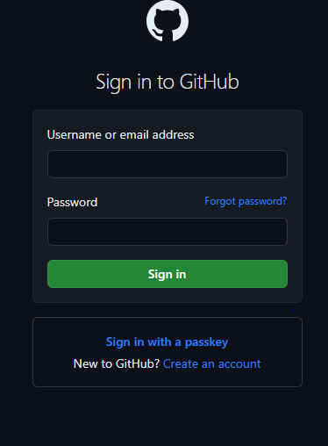
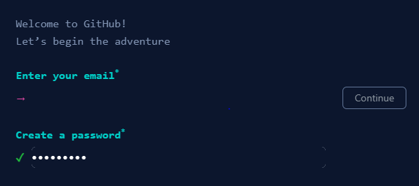
Creating a GitHub Account
Visit github.com, sign in with your account or create a new account if you don’t have one already.

Slide 30
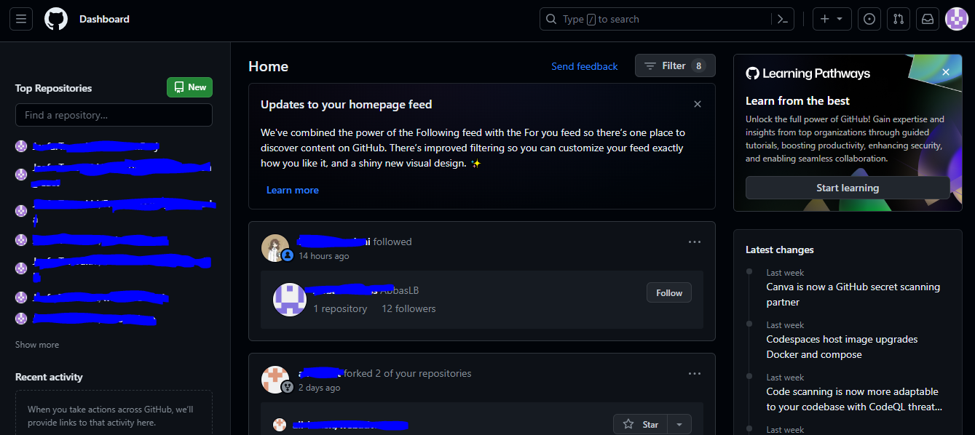
Navigating GitHub
Create a new repo with this green button
HERE YOU CAN FIND YOUR REPOSITORIES
Visit github.com, sign in with your account or create a new account if you don’t have one already.

Slide 31
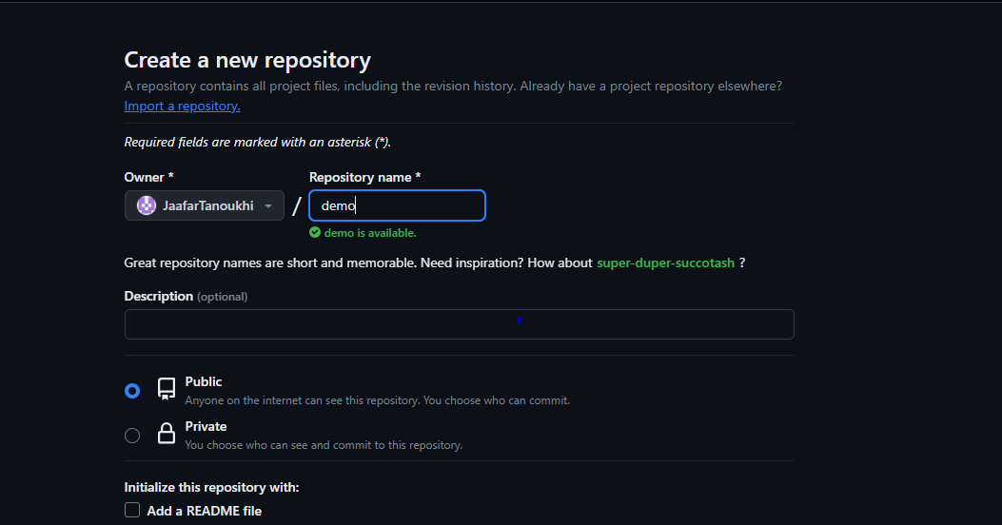
Creating a GitHub Repo
Click on new, then fill out this form, and click on create new repository

Slide 32
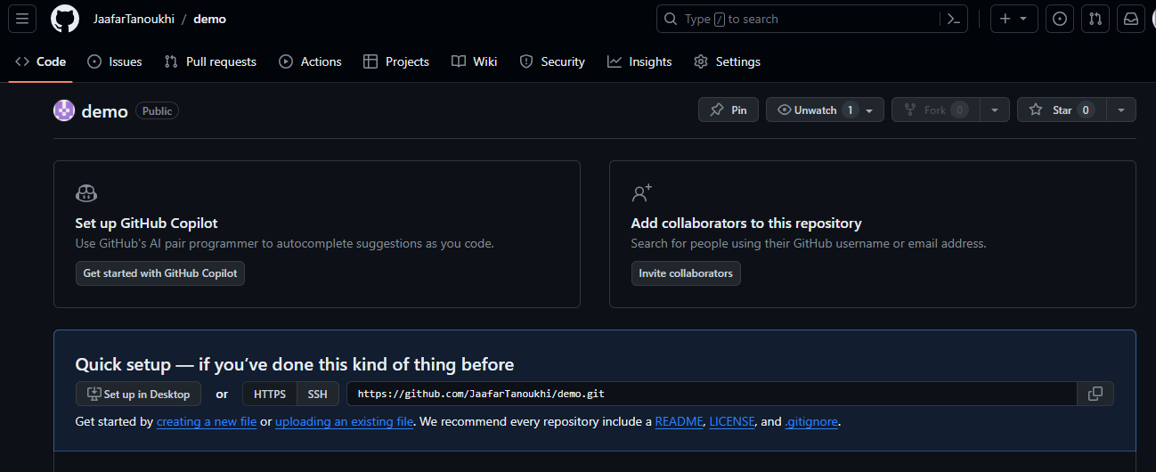
Creating a GitHub Repo
We have a new empty repo now.
Now we need to go back to using git

Slide 33
03
Git and GitHub

Slide 34
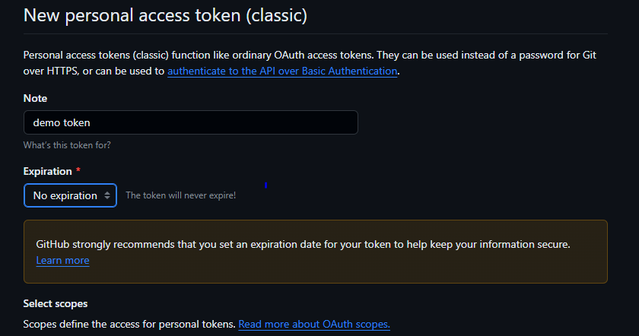
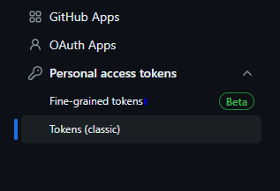
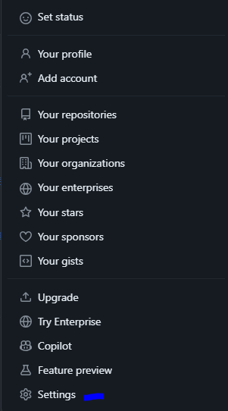
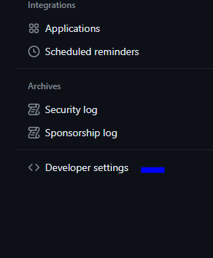
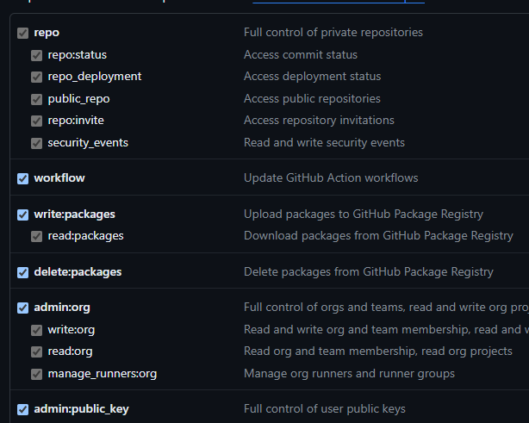
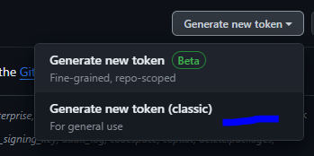

Generating Access Token

Slide 35
Generating Access Token

Slide 36


Setting Up Git for remote connections
Use your github username.
You will be asked to authenticate, when so enter your name and in case your password doesn’t work use the access token we generated.
Use your github email.
Origin is only the name of the remote here, you can name it whatever you’d like,
the url you can get from the repo or write it on your own with this format:
https://github.com/YourGitHubUsername/YourRepoName.git

Slide 37

Push and Pull in Git
git push <remotename> <remotebranch>
This allows to push your latest commit
to your github repo.
git pull <remotename> <remotebranch>
This allows to pull your latest commits
from the github repo.

Slide 38
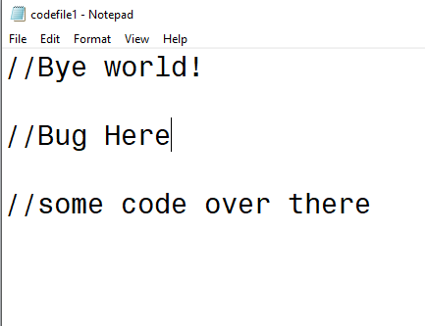
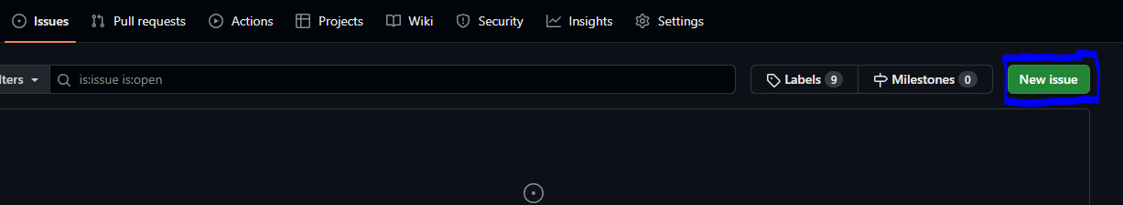
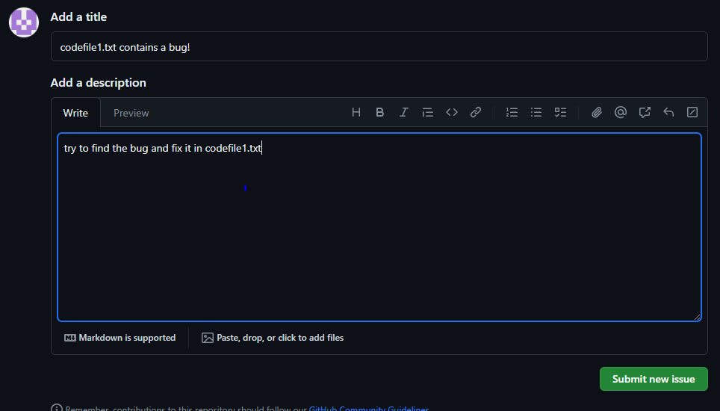
A Bug Appears
A while later, assume we found a bug in one of the codefiles. We can make this an issue on github, and some other developer could take this task and solve it.

Slide 39
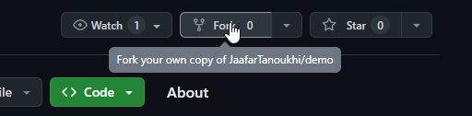
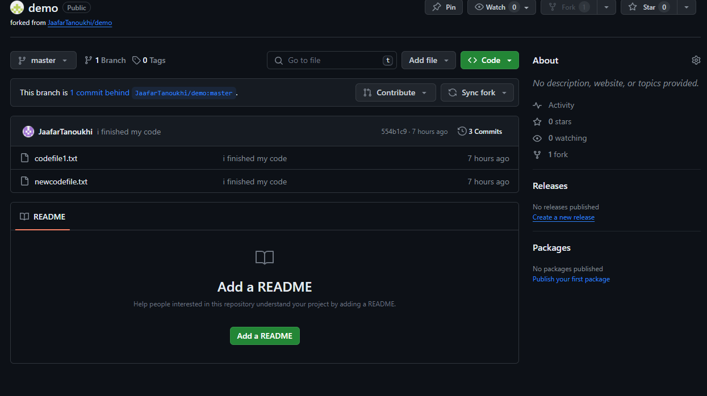
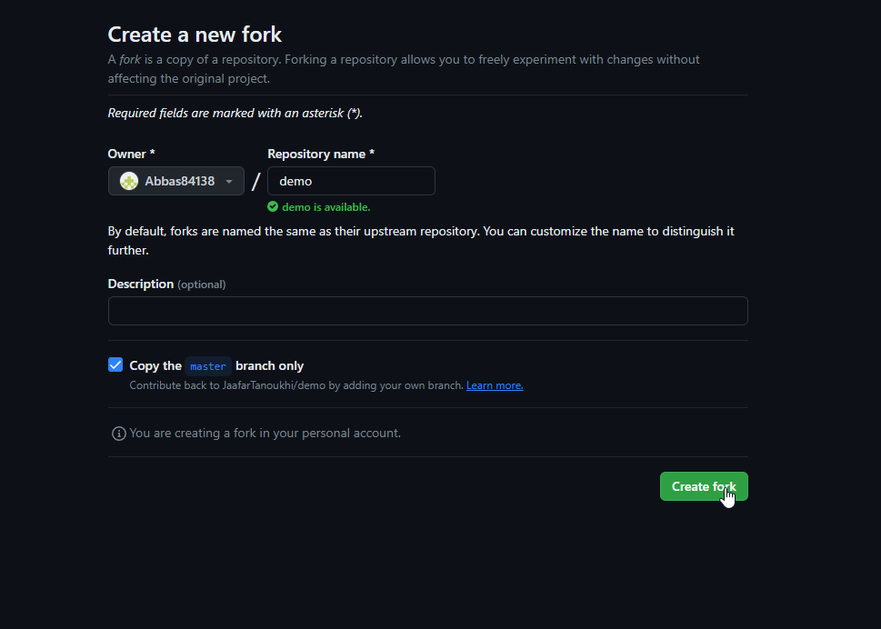
Fork A Repository
Forking a repository creates your own copy of this repo so you can work on your copy of the code.

Slide 40
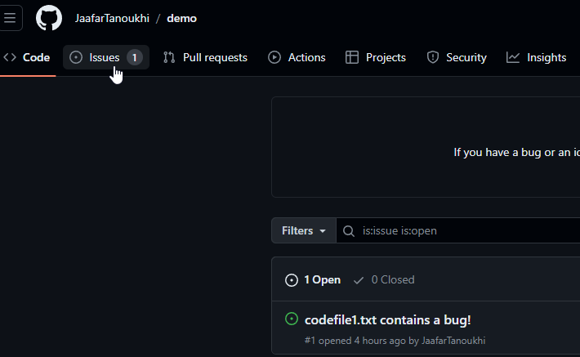
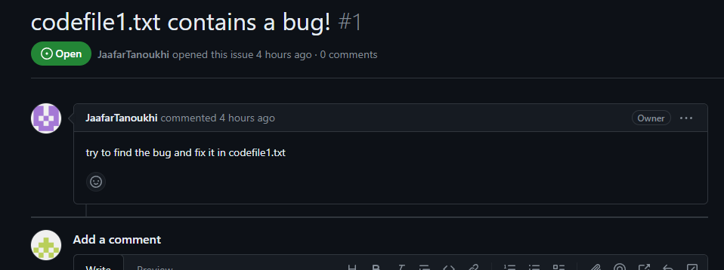
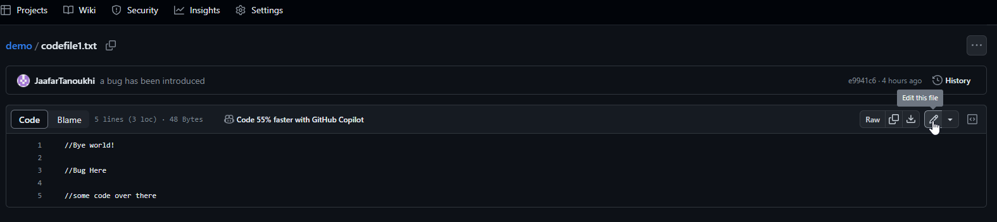
Fixing An Issue

Slide 41
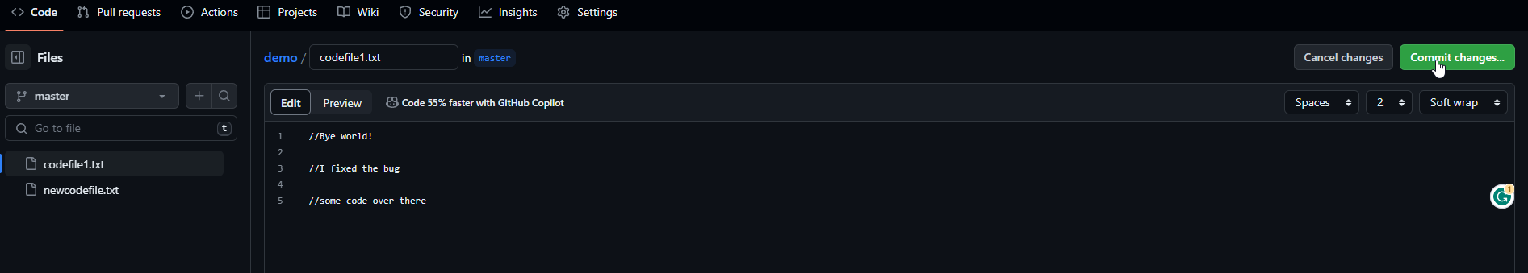
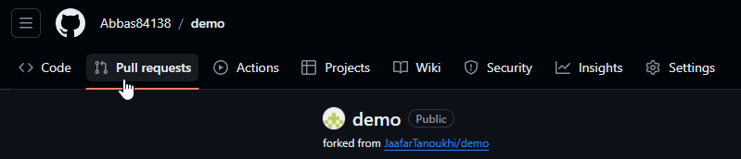
Fixing The Issue And Creating A Pull Request

Slide 42

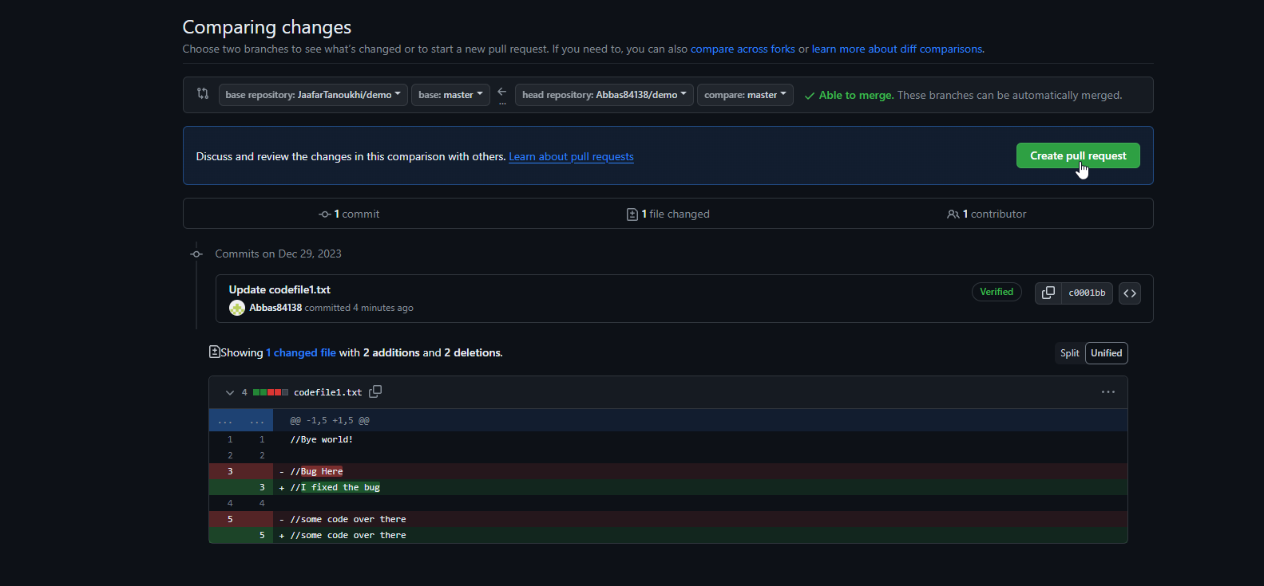
Pull Request

Slide 43
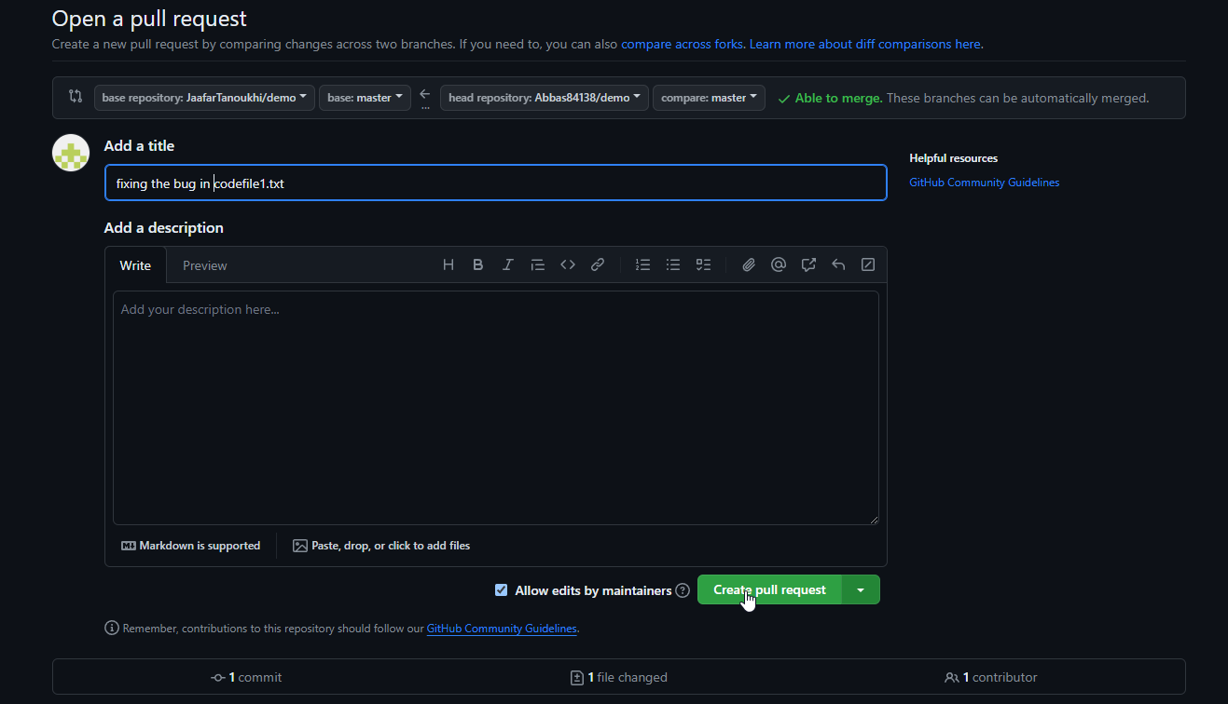
Pull Request
When creating a pull request, you can check the changes in the code, afterwards you have to add a descriptive title and a description of what you changed in the code and what was causing the issue.

Slide 44
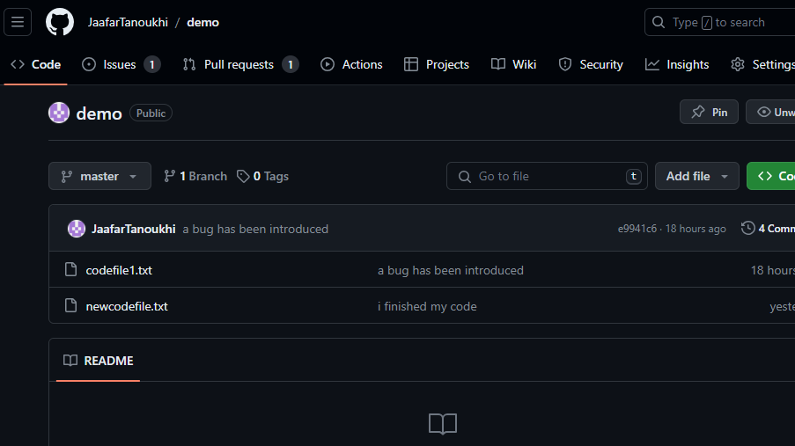
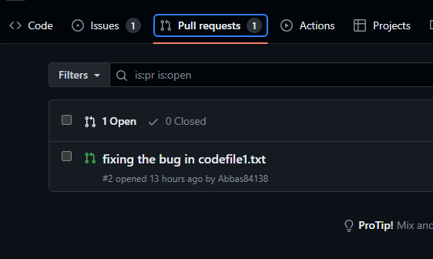
Accepting The Pull Request
We find that one developer has issued a pull request to fix the bug introduced earlier

Slide 45
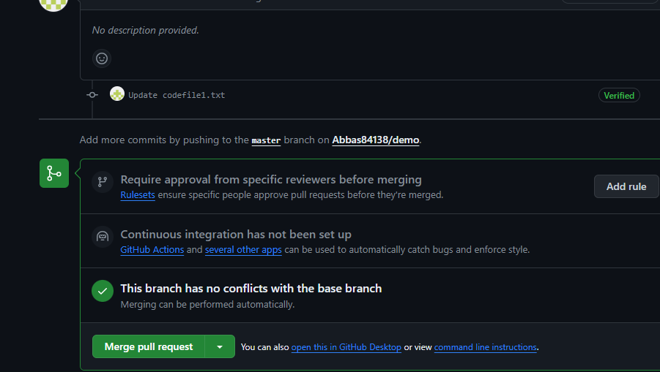


Merging The Pull Request And Closing the Issue
We merge the pull request and close the issue.

Slide 46
THANKS FOR LISTENING!
Made by Jaafar Tanoukhi, Abbas Badreddine, Sadek Yehya

Slide 47
RESOURCES
Official documentation from git-scm.com and GitHub's guides
Tutorials from YouTube
GitHub community forums Our own repository

